Slide 1

Policy Parameterizations
Notes:
1

Slide 2
Objectives
Understand Actor-Critic with Softmax policies
Understand Gaussian policies for continuous actions
Policy Parameterizations
2
Notes:
2

Slide 3
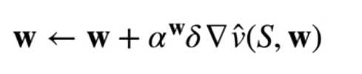
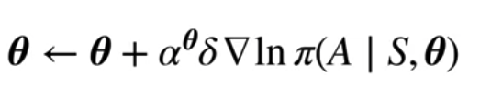
Actor-Critic with Softmax Policies
Actor-Scritic algorithm
The critic uses semi-gradient TD
The actor uses the TDR from the critic to update the policy parameters
Policy Parameterizations
3
Notes:
3

Slide 4
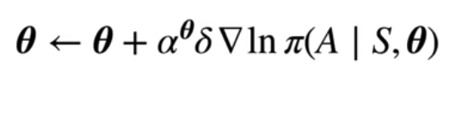
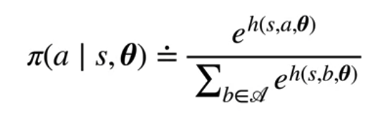
Actor-Critic with Softmax Policies
Policy update with a softmax policy
We use a Softmax policy that exponentiates the preferences and divides by the sum
Policy Parameterizations
4
Notes:
4

Slide 5
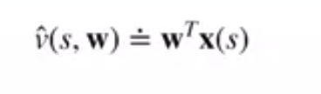
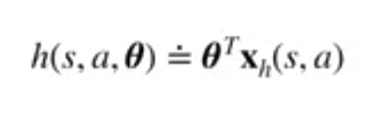
Actor-Critic with Softmax Policies
Features of the action preference function:
The actor's action preferences depend on the state and action
Policy Parameterizations
5
Notes:
5

Slide 6
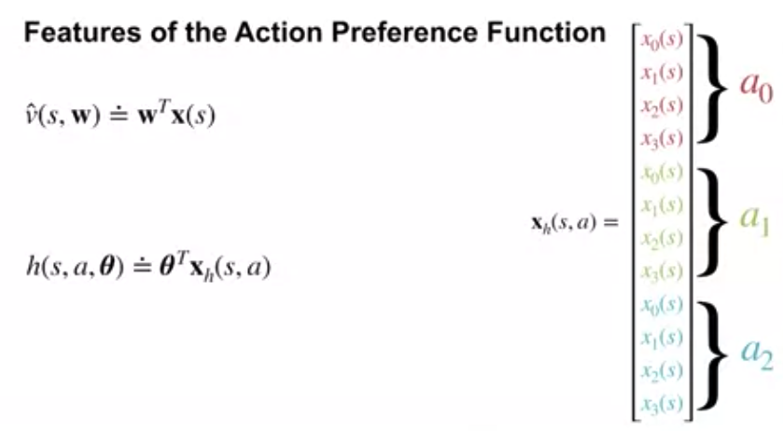
Actor-Critic with Softmax Policies
Using stacked state features
Policy Parameterizations
6
Notes:
6

Slide 7
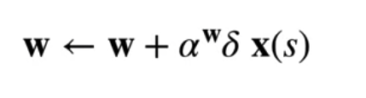
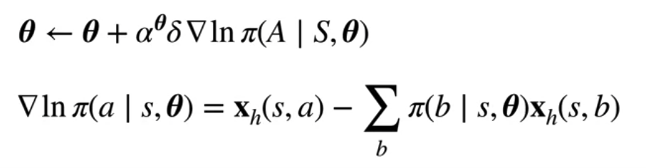
Actor-Critic with Softmax Policies
Actor-Scritic algorithm
The critic
The actor
Policy Parameterizations
7
Notes:
7

Slide 8
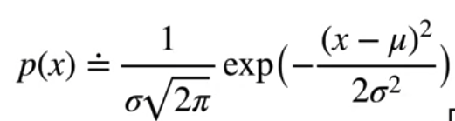
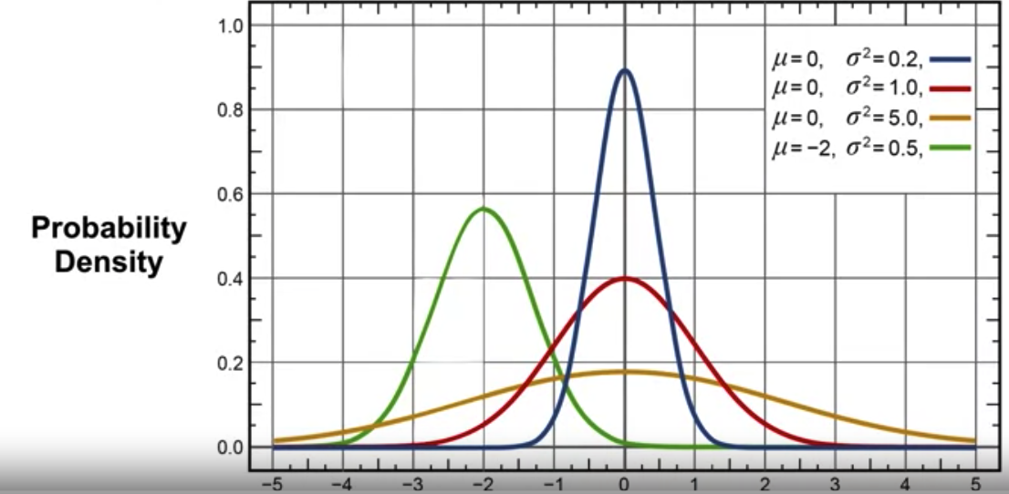
Gaussian policies for continuous actions
Gaussian Distribution
Example
Policy Parameterizations
8
Notes:
8

Slide 9
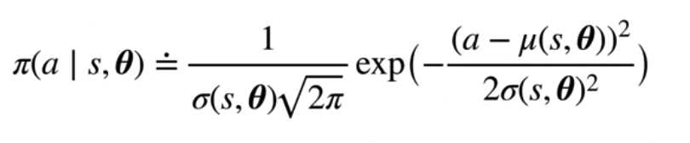


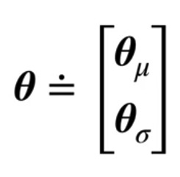
Gaussian policies for continuous actions
Define our policy using a Gaussian over actions.
Mu can be any parameterized function
The parameter's function Sigma must be positive.
The policy parameters
Policy Parameterizations
9
Notes:
9

Slide 10
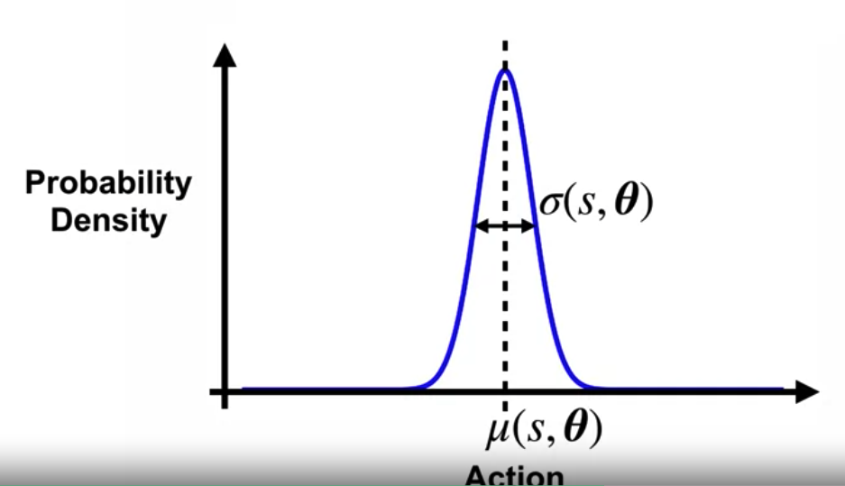
Gaussian policies for continuous actions
Gaussian Policies in Action
Sigma essentially controls the degree of exploration.
We typically initialize the variance to be large so that a wide range of actions are tried.
Policy Parameterizations
10
Notes:
10

Slide 11
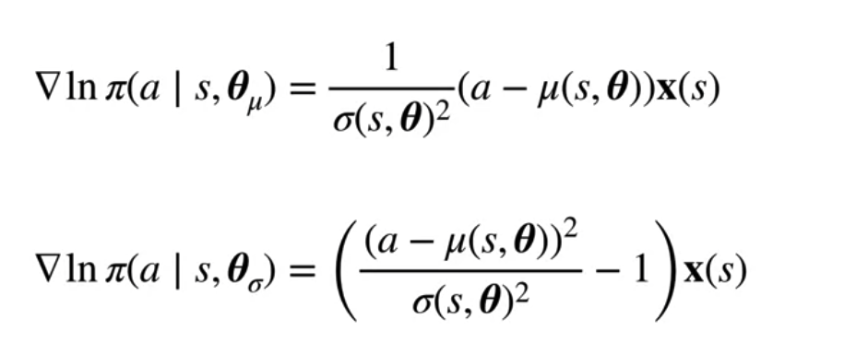
Gaussian policies for continuous actions
Gradient of the Log of the Gaussian policy
Policy Parameterizations
11
Notes:
11

Slide 12
Gaussian policies for continuous actions
Advantages of Continuous actions
It might not be straightforward to choose a proper discrete set of action
Continuous actions allow us to generalize over actions
Expressiveness: allow for a finer-grained control over actions, enabling agents to perform a wide range of subtle and precise movements.
Smoothness: often lead to smoother and more natural policies, as agents can smoothly transition between different action values.
Policy Parameterizations
12
Notes:
12

Slide 13
Gaussian policies for continuous actions
Advantages of Continuous actions
Efficiency: can lead to more efficient exploration and learning
Generalization: facilitate better generalization across similar actions
Optimization: are amenable to optimization techniques that rely on gradient-based methods, such as policy gradients or actor-critic algorithms
Policy Parameterizations
13
Notes:
13

Slide 14
Summary
Understand Actor-Critic with Softmax policies
Understand Gaussian policies for continuous actions
Policy Parameterizations
14

Slide 15
Q & A
Policy Parameterizations
15

